Slide 1


PROJECT PHASE2 PRESENTATION
INTRODUCTION & EXECUTION
NUTRI LENS AI
Presented By
K PREM KUMAR [24BK1A66BM]
NIRANJAN SINGH [24BK1A66BX]
PRINCE PATEL [24BK1A66CH]
K ANIL NAYAK[24BK1A66BH]
Guide Seminar Overall Coordinator HOD-CSE(AIML)
Mrs K Katyayani
Mrs K Katyayani
Dr. P. Deepan
https://spechyd.ac.in/ CSE(AIML) III YEAR I SEM Slide no 1
Notes:
Add Caption : Expect More
1
8/25/2026
archana

Slide 2
Introduction
    NUTRI LENS AI Helps people understand packaged food labels according to their health needs.
    It explains the ingredients, highlights possible risks and suggests healtheir food choices.
https://spechyd.ac.in/ CSE(AIML) III YEAR I SEM Slide no 2

Slide 3

Domain of the Project
Primary domain
  ARTIFICIAL INTELLIGENCE (AI) AND MACHINE LEARNING (ML)
AI/ML ENABLES NUTRI LENS AI TO ANALYZE FOOD INGREDIENTS AND RECOMMEND HEALTHIER FOOD CHOICES.
https://spechyd.ac.in/ CSE(AIML) III YEAR I SEM Slide no 3

Slide 4
Domain of the Project
SECONDARY DOMAIN
  NATURAL LANGUAGE PROCESSING (NLP): TO ANALYZE INGREDIENTS AND GENERATE UNDERSTANDABLE EXPLANATIONS.
  COMPUTER VISION AND OCR: TO EXTRACT TEXT FROM FOOD-LABEL IMAGES.
  HEALTH INFORMATICS: TO ORGANIZE AND INTERPRET NUTRITIONAL INFORMATION.
  RECOMMENDATION SYSTEMS: TO SUGGEST ALTERNATIVE FOOD PRODUCTS BASED ON NUTRITIONAL CRITERIA AND USER PREFERENCES.
https://spechyd.ac.in/ CSE(AIML) III YEAR I SEM Slide no 4

Slide 5
Problem Statement
  CONSUMERS STRUGGLE TO UNDERSTAND COMPLEX INGREDIENT LISTS ON PACKAGED FOODS.
  HIDDEN SUGARS, EXCESS SODIUM, AND UNHEALTHY FATS ARE DIFFICULT TO IDENTIFY.
  UNFAMILIAR ADDITIVES AND CHEMICAL NAMES CREATE CONFUSION.
https://spechyd.ac.in/ CSE(AIML) III YEAR I SEM Slide no 5

Slide 6
Problem Statement
  COMPARING NUTRITIONAL VALUES ACROSS DIFFERENT PRODUCTS IS TIME-CONSUMING.
  PEOPLE OFTEN LACK AWARENESS OF THE POTENTIAL EFFECTS OF CERTAIN INGREDIENTS.
  IDENTIFYING ALLERGENS AND DIETARY RESTRICTIONS REQUIRES CAREFUL LABEL CHECKING.
https://spechyd.ac.in/ CSE(AIML) III YEAR I SEM Slide no 6

Slide 7
Methodology
9-Step OpenCV Preprocessing Pipeline:
  Grayscale Conversion: Reduces computational overhead from 3-channel RGB to 1-channel luminance.
  Bilateral Filtering: Removes sensor noise while preserving critical text edges (σcolor​=75,σspace​=75).
  CLAHE (Adaptive Histogram Equalization): Corrects uneven supermarket lighting and flash glare.
  Morphological Gradient & Otsu Thresholding: Dynamically isolates character boundaries from packaging backgrounds.
  Deskewing & Affine Rotation: Detects text orientation via cv2.minAreaRect and realigns rotated labels.
  Morphological Closing & 5px Padding: Reconnects broken dot-matrix printing and prevents border truncation.
OCR Inference Engine:
  Powered by Google Tesseract 5.x LSTM Neural Network (--oem 1 --psm 6).
  Per-word confidence thresholding (≥60%) discards unreadable background artifacts.
https://spechyd.ac.in/ CSE(AIML) III YEAR I SEM Slide no 7

Slide 8
Tools
COMPUTER VISION
NLP & ALGORITHMS
BACKEND & DATABASE
• OpenCV (cv2)
• NumPy
• CLAHE & Otsu Algo
• Tesseract OCR (v5.x)
• PyTesseract Engine
• Python Regex (re)
• Fuzzy String Matcher
• Python 3.10+
• Flask / RESTful API
• MySQL 8.0
FRONTEND & CLIENT
DEVELOPMENT & TESTING
REGULATORY STANDARDS
• HTML5, CSS3, ES6+ JS
• WebRTC (Camera Stream)
• Visual Studio Code
• Git & GitHub
• FDA Big 9 Guidelines
• EU 14 Allergen FIC
• CODEX Alimentarius
• Glycemic Index Tables
https://spechyd.ac.in/ CSE(AIML) III YEAR I SEM Slide no 8

Slide 9












Architecture
[START] User opens NutriLens AI Web
1. User Authentication
2. Health Profile → Select Allergies (Nuts, Milk), Conditions (Diabetes), Diets (Vegan)
3. Food Label Capture
4. Computer Vision+OCR → OpenCV deskews &
enhances → Tesseract extracts text
5. Rule Engine Match → Matches ingredients against
user profile
6. Explaniable Verdict → Displays 🟢 SAFE / 🟡
CAUTION / 🛑 AVOID + Safe Alternatives
https://spechyd.ac.in/ CSE(AIML) II YEAR I SEM Slide no 9

Slide 10
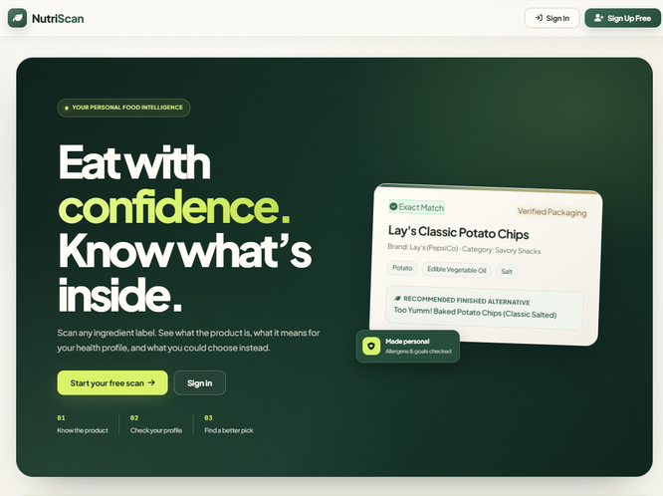
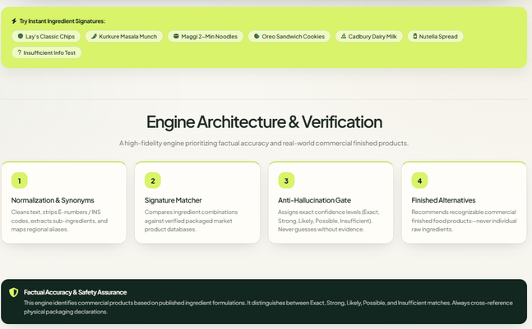
Execution
https://spechyd.ac.in/ CSE(AIML) II YEAR I SEM Slide no 10

Slide 11
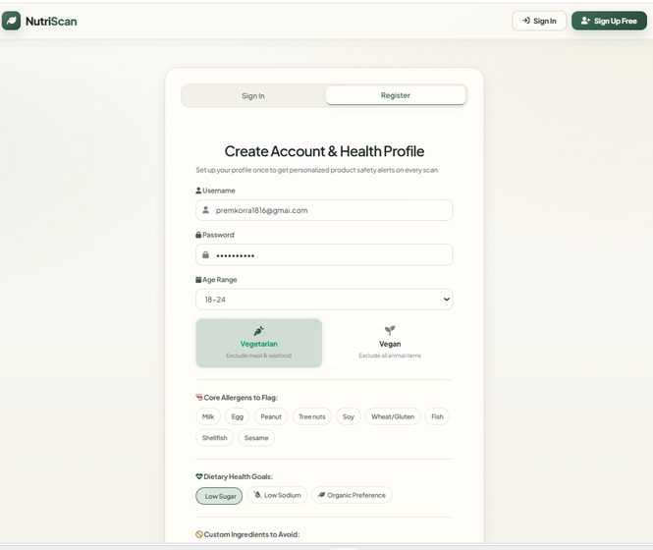
Execution-user profile
https://spechyd.ac.in/ CSE(AIML) II YEAR I SEM Slide no 11

Slide 12
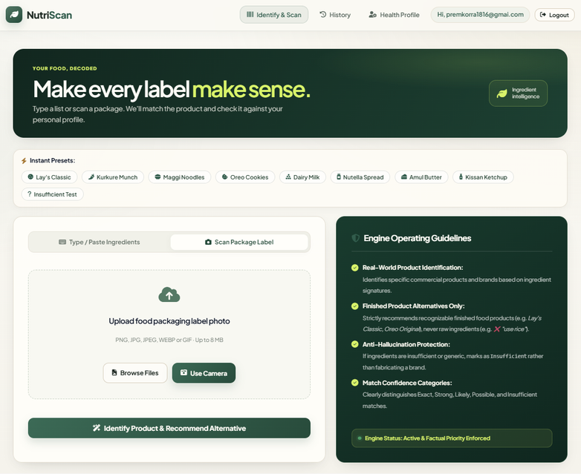
Execution-After Regestration
https://spechyd.ac.in/ CSE(AIML) II YEAR I SEM Slide no 12

Slide 13
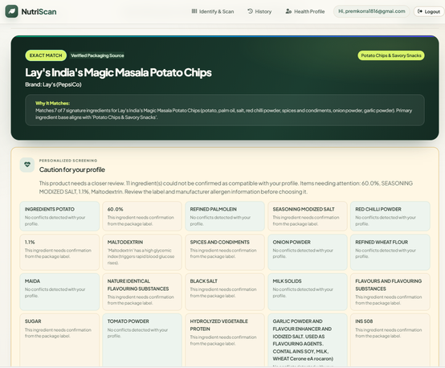
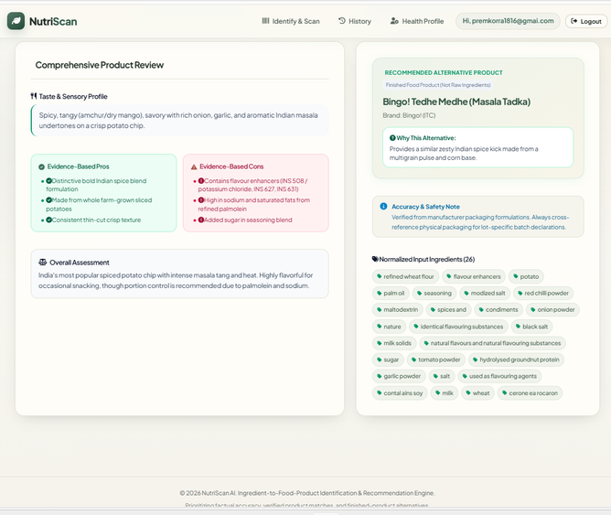
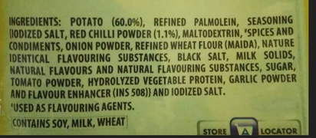
Output
Input Image
https://spechyd.ac.in/ CSE(AIML) II YEAR I SEM Slide no 13

Slide 14
Conclusion
  Automated Food Label Analysis: Converts fine-print packaging into clear text using OpenCV & Tesseract OCR.
  Reliable & Zero Hallucination: Deterministic rule engine cross-referenced against 2,500+ verified ingredients.
  Instant Results: Delivers personalized verdicts (SAFE / CAUTION / AVOID) in under 2 seconds.
https://spechyd.ac.in/ CSE(AIML) II YEAR I SEM Slide no 14

Slide 15
Questions????
https://spechyd.ac.in/ CSE(AIML) II YEAR I SEM Slide no 15

Slide 16


